Slide 1
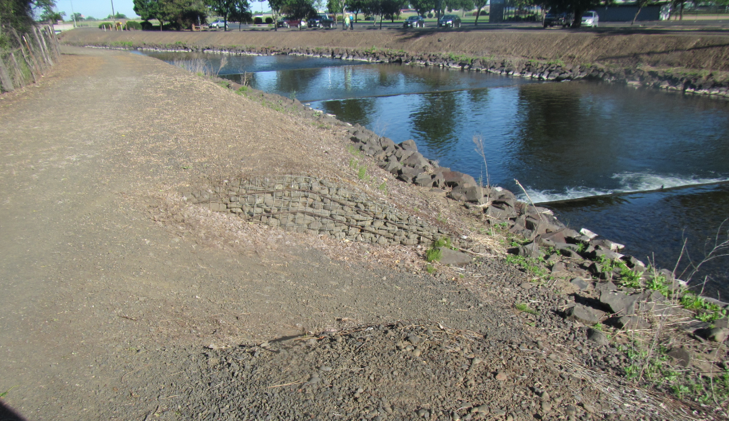
typical mill creek Levee
Wire Bound “Gabion” Revetment
Approx. Levee Slope
Levee Fill
2H
1V
Channel Stabilizer
Riprap Revetment

Slide 2
Improved channel condition
Annual inspections under Levee Safety Program have typically found only minor issues with both Federal and Non-Federal portions
Levees have good historical performance (no significant issues documented from ‘96 flood)
Majority of levees are low height (6 ft or less)
Gabion structures and riprap stone provide erosion protection
However, some uncertainties exist:
Original construction history not documented well (materials, compaction, etc)
Limited survey data on Non-Federal improved channel
Limited details on levees previously raised/modified

Slide 3
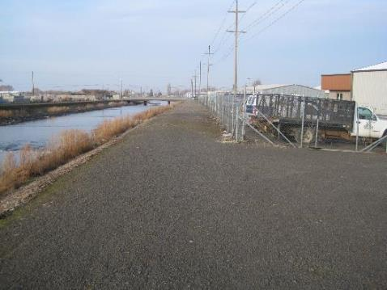
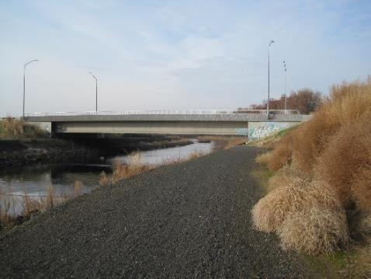
Improved channel condition
Some portions called levees are actually considered to be bank protection as the ground surface is at or above the crest elevation

Slide 4
Current Levee raise plan
Part of the TSP includes raising some of the channel levees up to 1.5 feet to more closely match the existing capacity of the rest of the system
Some crest widening will be needed but only for a few localized areas
Address encroachments, utility relocations, and removing/replacing fences as needed
Construct permanent access ramps for maintenance and emergency use

Slide 5
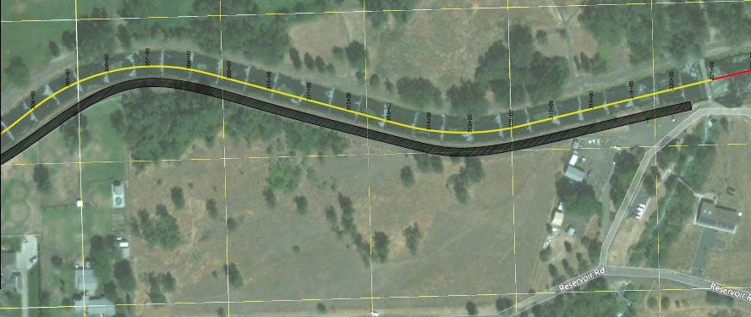
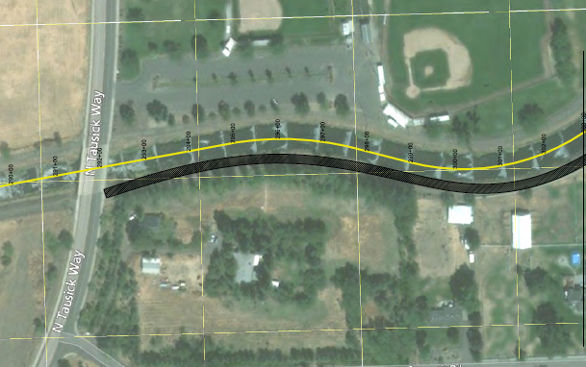
Current Levee raise plan
Raise levees up to 1 foot on the left bank (south side) between the Division Works and Tausick Way
Division Works
Approximate channel centerline
Potential levee raise area

Slide 6
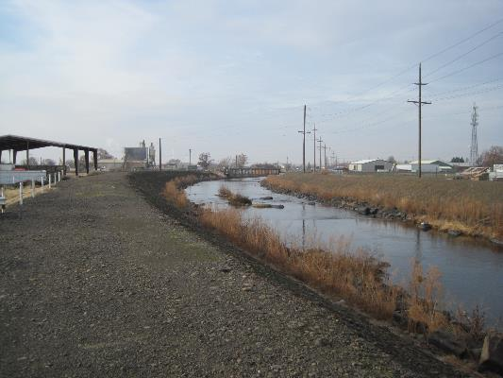
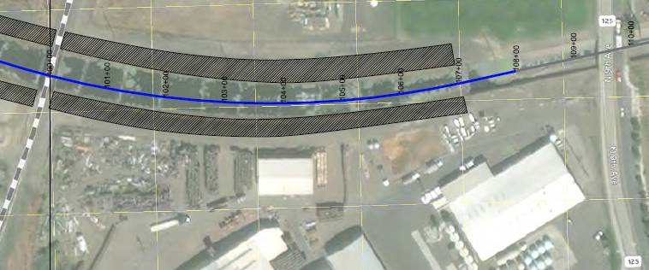
Current Levee raise plan
Other location is a 0.7 foot raise on the left bank between 9th Ave and the railroad bridge. Right bank was considered but may not need to be raised

